Slide 1
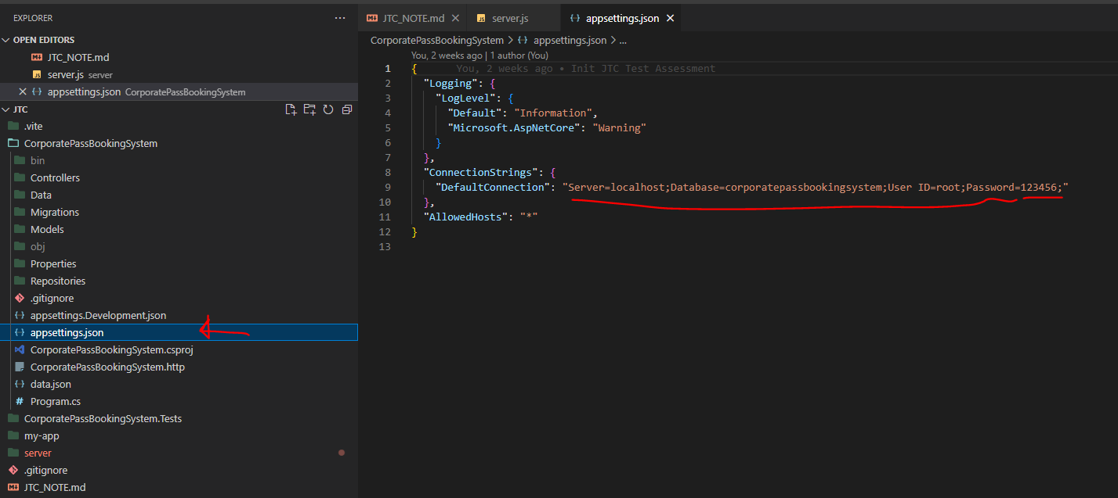
Modify the appsettings.json with the connection string
For the local or remote database
Server was my Node.js REST API program, since the test assignment required .NET Entity Framework
CorporatePassBookingSystem was build up from scratch with entity framework and C# code

Slide 2
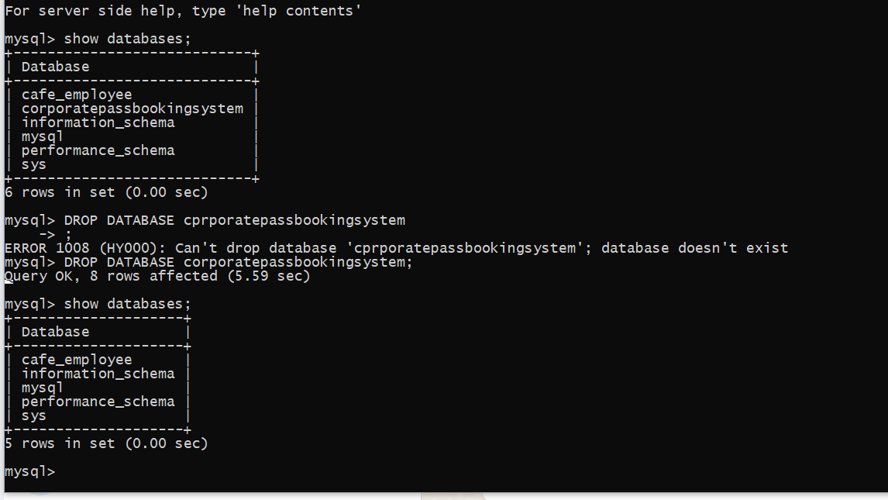
- logging to direcrtory CorporatePassBookingSystem
SETUP OF DATABASE AND TABLES
- In Terminal run : dotnet ef migrations InitializeDB
- In Terminal run : dotnet ef database update

Slide 3
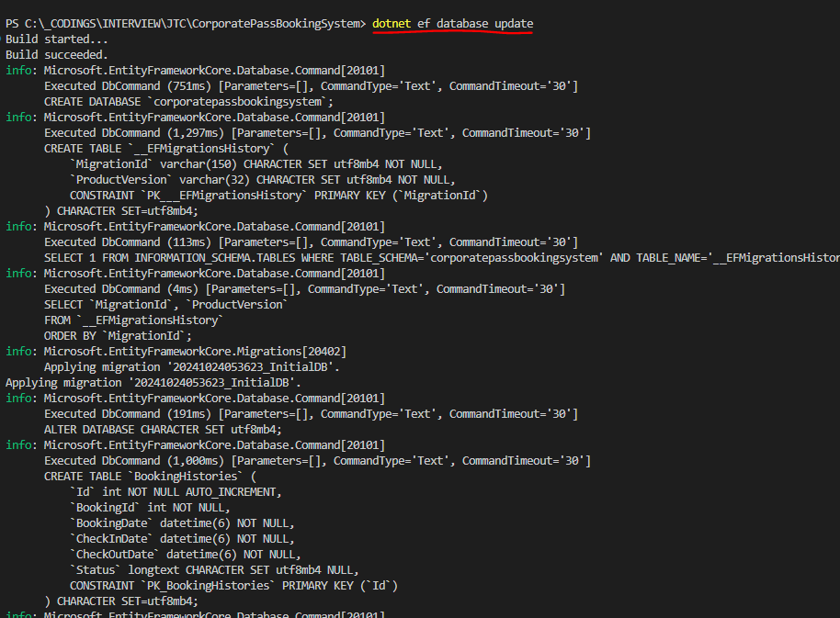
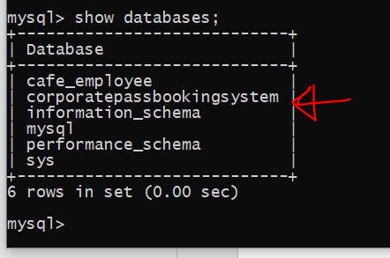
NEW DATABASE TABLE CREATED
AFTER EXECUTE
Dotnet ef database update

Slide 4
SETUP OF REST API (WEBAPI)
- In Terminal run : dotnet build -> To builld the solution in \bin
- In Terminal run : dotnet run -> This will fired up the REST API Server
- In Browser type : http://localhost:5120/swagger/index.html -> This will run swagger to verify and check on the EndPoints
o GET /api/facilities – List all facilities
o GET /api/facility/{id} – Get a single facility
o GET /api/bookings – Get all booking list
o GET /api/bookings/{VisitorId} – Get booking by visitor
o GET /api/booking/{id} – Get a single booking
o POST /api/booking – Create a booking
o PUT /api/booking – Update a booking
o GET /api/visitors – Get all visitors
o GET /api/visitor/{id} – Get a single visitor
o POST /api/visitor – Create a visitor
o PUT /api/visitor – Update a visitor

Slide 5
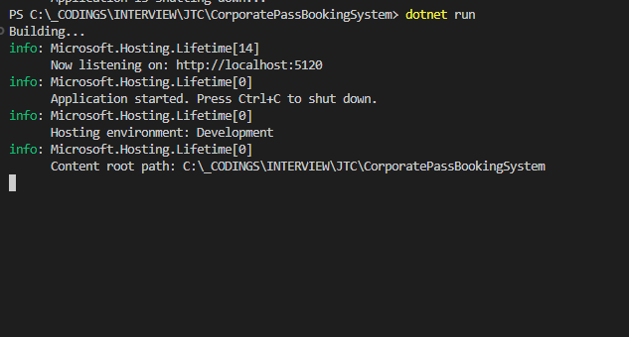
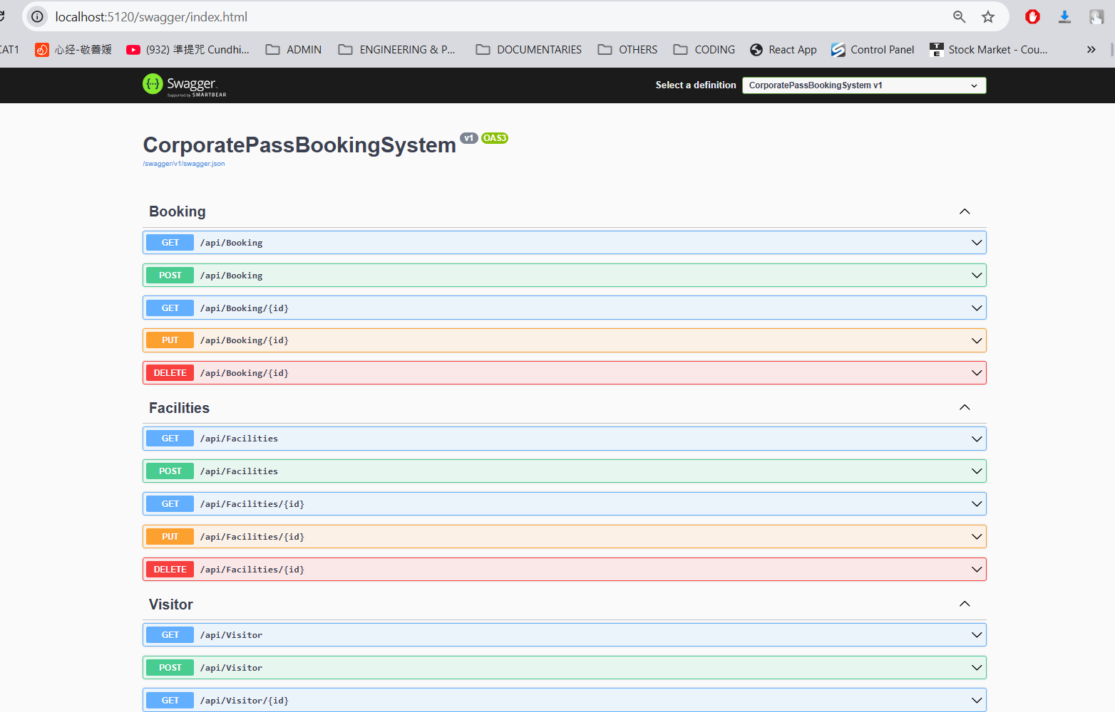
After running dotnet build with \bin and \obj will be created
Run dotnet run to fire up the REST API that become the Endpoint that FrontEnd App can access.
You can also in browser start swagger to check and test the API
http://localhost:5120/swagger/index.html

